Slide 1
Highway Planning & Design
Lecture - 3
Designed and presented
By
Asst. Prof. Dr. Raquim Nihad Zehawi

Slide 2
SIGHT DISTANCE
Sight distance is the length of the roadway ahead that is visible to the driver
For safety on highways, the designer should provide sight distance of sufficient length that drivers can control the operation of their vehicles to avoid striking an unexpected object in the traveled way.
Two-lane highways should also have sufficient sight distance to enable drivers to occupy the opposing traffic lane for passing other vehicles without risk of a crash
Stopping Sight Distance
Passing Sight Distance

Slide 3
Stopping Sight Distance
The available sight distance on a roadway should be sufficiently long to enable a vehicle traveling at or near the design speed to stop before reaching a stationary object in its path
Stopping sight distance is the sum of two distances:
the distance traversed by the vehicle from the instant the driver sights an object to the instant the brakes are applied
(1) brake reaction distance
the distance needed to stop the vehicle from the instant brake application begins
(2) braking distance

Slide 4
Brake Reaction Time
The interval from the instant that the driver recognizes an obstacle on the roadway ahead to the instant that he actually applies the brakes
The recommended design criterion of 2.5 s for brake reaction time exceeds the 90th percentile of reaction time for all drivers
Break Reaction Distance = 0.278V t
t = brake reaction time, 2.5 s
V = design speed, km/h

Slide 5


Braking Distance
The braking distance of a vehicle on a level roadway traveling at the design speed may be determined from the equation:
The recommended deceleration rate is 3.4$m{/s}^{2}$

Slide 6
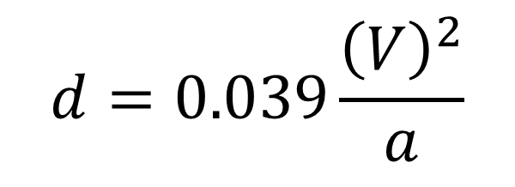
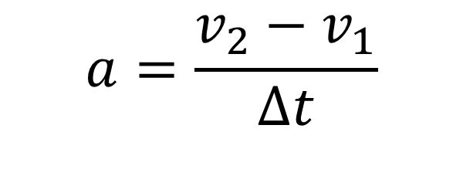
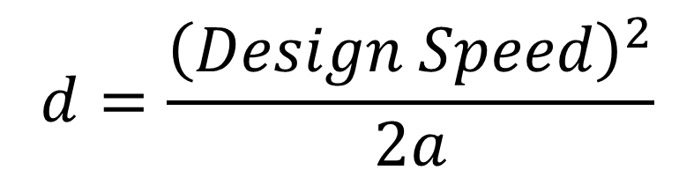
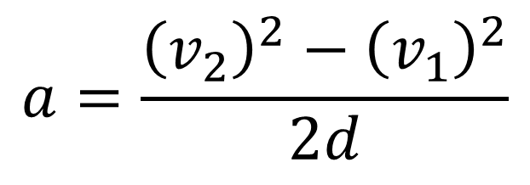
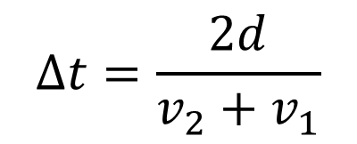
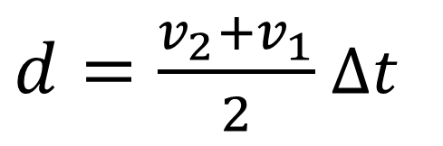
$$a=\frac{v_{2}−v_{1}}{∆t}$$
In the case of linear acceleration:
$$a=\frac{{\left(v_{2}\right)}^{2}−{\left(v_{1}\right)}^{2}}{2d}$$
$d=\frac{v_{2}+v_{1}}{2}$ $∆t$
$$∆t=\frac{2d}{v_{2}+v_{1}}$$
$$d=\frac{{\left(Design Speed\right)}^{2}}{2a}$$
In the case of linear breaking deceleration:
ie. V2 =0 & a is negative
$$d=0.039\frac{{\left(V\right)}^{2}}{a}$$
If Design Speed (V) is in Km/h
Deceleration rate (a) is in m/s^2
Breaking Distance (d) in m

Slide 7
Design Values
Stopping sight distance (SSD) is the sum of the distance traversed during the brake reaction time and the distance to brake the vehicle to a stop

Slide 9


Effect of Grade on Stopping
When a highway is on a grade, the equation for braking distance should be modified as follows:
S.S.D in meters
v= speed km/hr
t= perception- reaction time (usually=2.5sec)
f= friction
G= slope (up +ve, down –ve)
AASHTO represents the friction coefficient (f) by ( a/g) where a= constant rate of deceleration =3.4m/sec2
when g= 9.81 m/sec2 then a/g= 0.35

Slide 10
Passing Sight Distance for Two-Lane Highways
The minimum passing sight distance is the sum of the following four distances:
- d1—Distance traversed during perception and reaction time and during the initial
acceleration to the point of encroachment on the left lane
- d2—Distance traveled while the passing vehicle occupies the left lane.
- d3—Distance between the passing vehicle at the end of its maneuver and the
opposing vehicle.
d4—Distance traversed by an opposing vehicle for two-thirds of the time the
passing vehicle occupies the left lane, or 2/3 of d2 above.

Slide 11
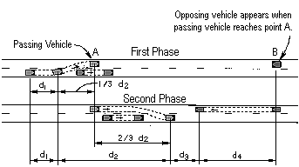
Exhibit 3-4. Elements of Passing Sight Distance

Slide 12
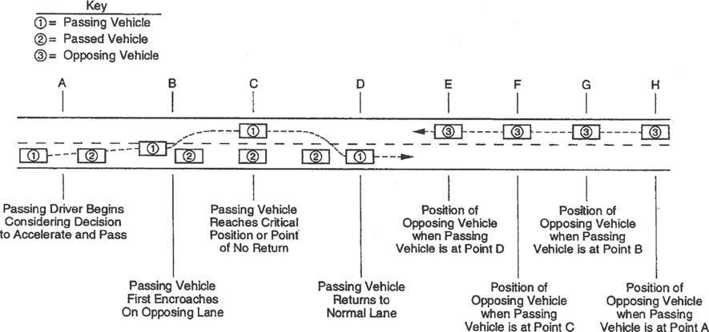
Components of the passing maneuver used in passing sight distance criteria

Slide 14
Initial maneuver distance (d1)
The initial maneuver period has two components
1- A time for perception and reaction
2- An interval during which the driver brings the vehicle from the trailing speed to the point of
encroachment on the left or passing lane
The distance (d1) is computed with the following equation:

Slide 15
Distance while passing vehicle occupies left lane (d2)
The distance d2 traveled in the left lane by the passing vehicle is computed with the following equation:

Slide 16
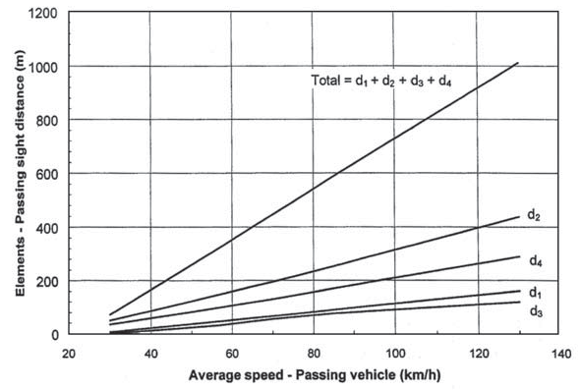
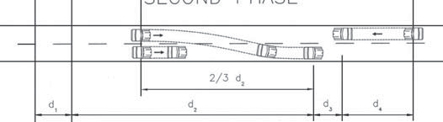
Clearance length (d3)
The clearance length between the opposing and passing vehicles at the end of the passing maneuvers varies from 30 to 75 m.

Slide 17
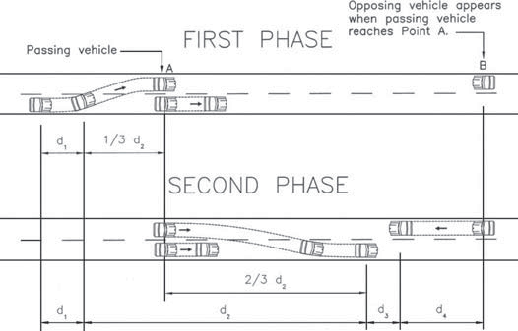
Distance traversed by an opposing vehicle (d4)
(d4): Is the distance traversed by an opposing vehicle during two thirds of the time the
passing vehicle occupies the left lane

Slide 18
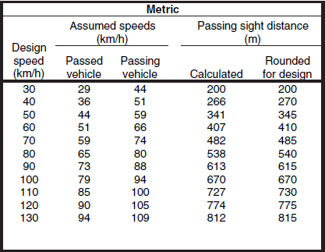
Design Values
The minimum passing sight distance is determined by the sum of the elements d1 through d4
It is calculated for a vehicle to passing another one that travels 15 km/h [10 mph] slower, while the opposing vehicle is traveling at the same speed as the passing vehicle

Slide 19
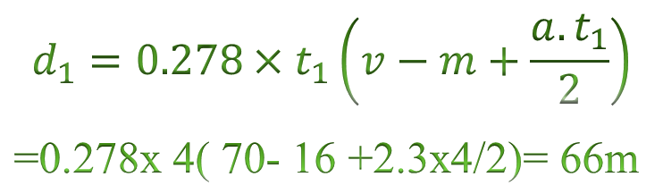
Example: find the minimum passing sight distance
Assumptions:
v= 70 km/hr,
m=16 km/hr,
a=2.3 km/hr/sec,
t1 =4sec,
t2 =10 sec
$$d_{1}=0.278×t_{1}\left(v−m+\frac{a.t_{1}}{2}\right)$$
=0.278x 4( 70- 16 +2.3x4/2)= 66m
d2=0.28 v t2= 0.28x70x10 = 196m
d3 = assumed to be 55m for this speed
d4=2/3 d2= 2x196/3= 131m
Total passing sight distance = 448m

